Slide 1
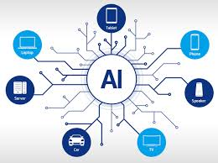
Artificial Intelligence (AI)
JAMEL BEN CHAFRA

Slide 2
What is AI?
Is the intelligence of machines or softwares, as opposed to the intelligence of human beings or animals.
Is a field which combines computer science and robust datasets to enable problem-solving.
Includes sub-fields of machine-learning and deep learning.
Notes:
Don’t forget to mention that AI emerged as an academic discipline in 1956!

Slide 3
AI projected GDP Contribution (2030)
Region / Country | GDP projected Contribution (2030)
China | 26.10 %
North America | 14.50 %
United Arab Emirates | 13.60 %
Kingdom of Saudi Arabia | 12.50 %
Southern Europe | 11.50 %
Egypt | 7.70 %
Latin America | 5.40 %

Slide 4
AI Applications
Search engines
Targeting online advertisements
Recommendation systems
Driving internet traffic

Slide 5
AI Limitations
Neat vs. scruffy
Soft vs. hard computing
Narrow vs. general AI

Slide 6
AI Limitations
Neat vs. scruffy
Soft vs. hard computing
Narrow vs. general AI
Machine consciousness

Slide 7
AI or not AI )))

